Slide 1
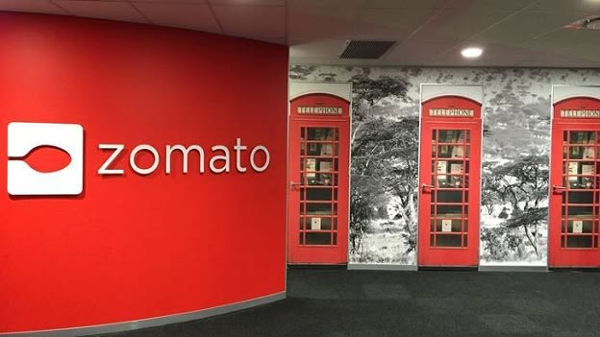
Zomato Restaurant Analysis Mohit Sehrawat

Slide 2

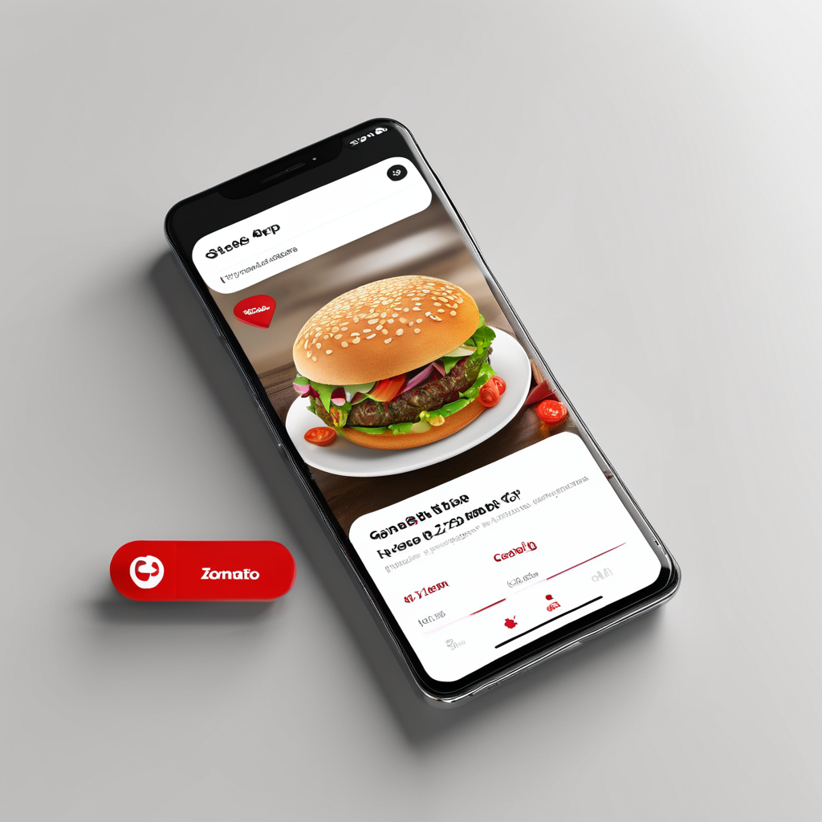
Introduction to Zomato
History
Zomato was founded in 2008 as a restaurant discovery platform in India. It started as a website that provided information about restaurants, including menus, reviews, and ratings.
Mission
Zomato's mission is to ensure that everyone can find and enjoy great food. They aim to connect users with the best dining experiences by providing accurate and comprehensive information about restaurants.
User Base
Zomato has a large and diverse user base, with millions of active users worldwide. It is available in multiple countries and supports multiple languages, making it accessible to a global audience.

Slide 3
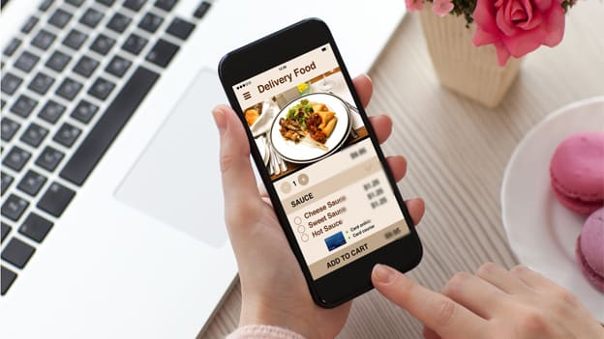
Project Aim
The objective of the project is to analyse the data of Zomato restaurants across the country and retrieve some meaningful insights for the growth of the business.

Slide 4
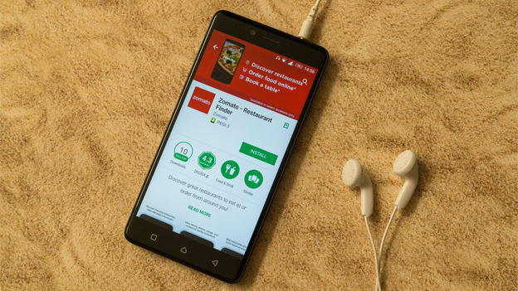
How Zomato Works
1 Search for Restaurants
2 View Restaurant Details
3 Place an Order
4 Payment
5 Delivery
6 Review

Slide 5
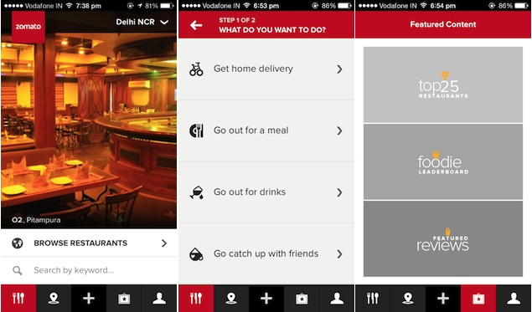
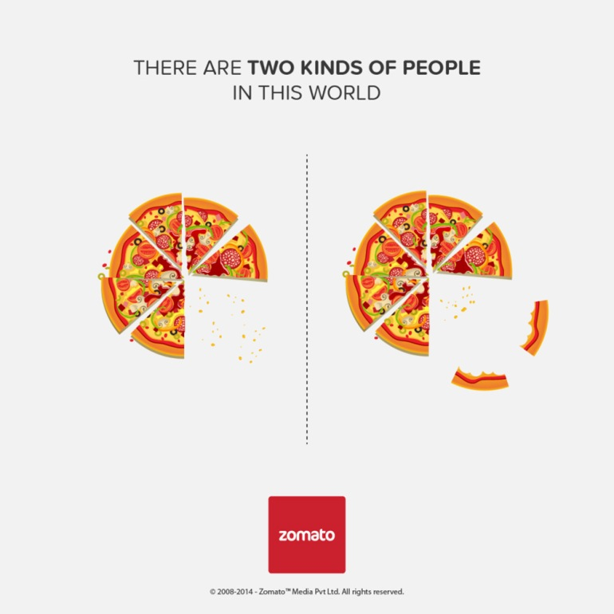
Data overview and data cleaning
Data Overview
There are total 9551 restaurants in the world wide.
Most number of the restaurants were opened in year 2018.
We can see most of the restaurants have online deliveries and table bookings both.
Restaurants have price range between 1- 4.
Different restaurants has different ratings based on their cities cuisines and price range.
Data Cleaning
There are null values present in columns Longitude, Latitude and votes are replaced by their average respectively.
There are 9 blank cells found in the column cuisines are replaced by cuisines based on their country codes.
All currencies are updated in the Indian Rupees in the new column created named as currency Updated.
Year is extract from the column Datekey_Opening.
Data is well maintained with help of wrap text, borders and Bold functions.

Slide 6

Methodology
Handling missing values – Using average function missing are handled.
Data Enrichment – Enhance the data with help of VLOOKUP, count if, conditional formatting and left functions.
Pictorial Visualization – Using of Pivot Tables, Different charts helps to overcome the data very easily and handy.
Segregation of Data – Data is separated by using filters, slicers year wise, country wise, range wise and so on.
Data Visualization – Created interactive dashboard of the whole data, so that we can check most of thing on single click.

Slide 7
Growth in market
Almost more than 1000 restaurants were opened each year.

Slide 8
Customer View
Philippines defeating all countries in terms of ratings.
Whereas India is at the bottom of the list on scale of average ratings.

Slide 9
Analysis of Cuisines
North Indian cuisines are on top of the table on the basis of average cost of two in Indian rupees.

Slide 10
Types of Bookings
The restaurants those which have table bookings are 55% and rest 45% does not have table bookings.
The restaurants those which have online bookings are 54% and rest 46% does not have Online bookings.

Slide 11
Analysis
India represents the most dominating market of Zomato affiliated restaurants with market share of more than 8000 restaurants.

Slide 12
Countries Demanded on basis of votes
Indonesia is the only country which crosses the average line of 500 votes and got highest number of average votes defeating all the countries worldwide.

Slide 13
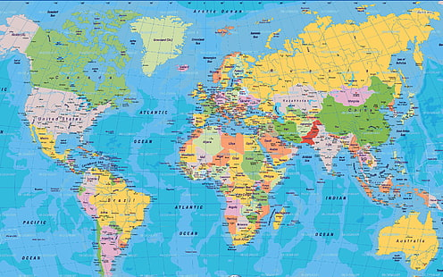
Country selection for opening new restaurant
Canada - based on the number of restaurants were already presents there were 4 and having average ratings of more than 3.5
Qatar - based on the number of restaurants were already presents there 20, having average ratings of more than 4 and have more than 163 of average voters.
United states of America - based on the number of restaurants were already presents there were 434 but having average ratings of more than 4, and have more than 428 of average voters and also has online delivery available.

Slide 14
Distribution of number of restaurants among different price in all countries
Different countries have different number of restaurants within the different price range. Whereas India have the maximum number of the of the restaurants among all price ranges. States such as the United States, United Kingdom, and South Africa have a more balanced distribution across the different price ranges but with significantly lower totals compared to India. Countries like Indonesia, Sri Lanka, and Qatar, have minimum number of restaurants.

Slide 15
Country wise expenditure
Here we can say countries like India, Indonesia and Turkey are having lowest expenditure cost.

Slide 16
Recommendation for opening new restaurants
Canada Consort
4931 50th Street, Consort, AB T0C 1B0
Qatar Doha
1st Floor, The St. Regis Hotel, Westbay, Doha
2nd Floor, The Gate Mall, Dafna, Doha
United States of America Cochrane
130 Quarry Street, Unit 20, Cochrane, AB T4C 0W5
Miller
109 N Broadway Ave, Miller, SD 57362
Potrero
1020 Barrett Lake Rd, Dulzura, CA 91917

Slide 17
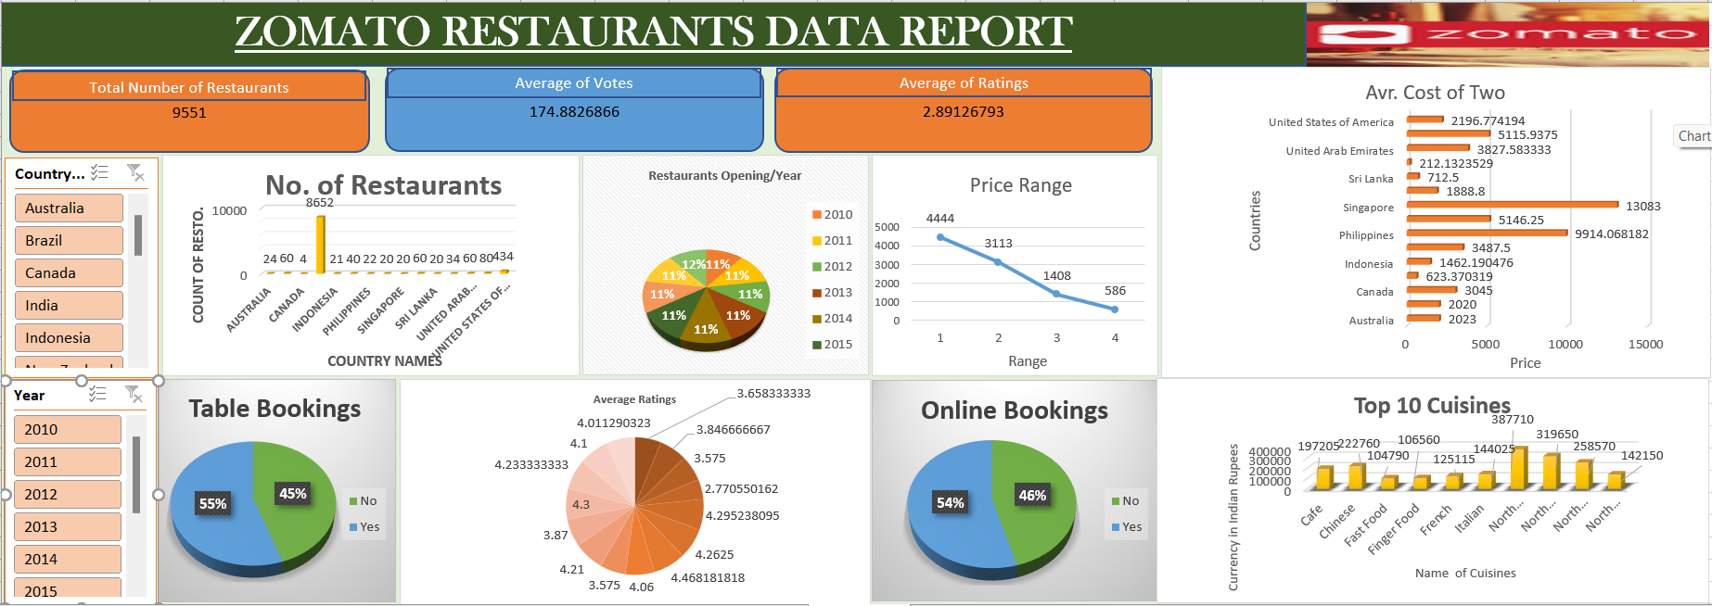
Dashboard

Slide 18
Recommendations
Zomato should capitalize on its multi-cuisine approach to cater to diverse tastes, enhancing its appeal to a broader customer base.
Canada, Qatar and united states of America are some of the most unclustered markets for Zomato that may offer new opportunities for market penetration.
Customers are also ready to spend more money according to there need.
Online delivery and table booking generally exceed into a higher rating.
This approach to cuisine selection ensures that investments are tailored to the financial capacities and strategic goals of the stakeholders, maximizing the potential for success in the chosen markets.

Slide 19
Conclusion
In conclusion, our analysis of Zomato restaurant data reveals promising opportunities for strategic expansion across the globe. By targeting regions with high demand, catering to specific demographic preferences, and capitalizing on competitive advantages, we can confidently recommend the opening of new restaurants. This initiative not only enhances market presence but also delivers exceptional dining experiences, driving sustainable growth for Zomato and enriching the global culinary landscape.

Slide 20
Thankyou

